Slide 1
Crisis & Resilience Fund (CaRF)
Simon Kitchen
Assistant Director: Communities
Devon County Council – Public Health & Communities

Slide 2
Not the Household Support Fund
“The Crisis and Resilience Fund enables local authorities to provide immediate crisis support while investing in long‑term financial resilience, shifting local welfare systems from reactive emergency response to prevention and stability. DWP”
Provide a safety net for low‑income households experiencing a financial shock (Households with limited financial resources who experience a sudden and unforeseen drop in income or increase in essential costs that they cannot absorb without hardship)
Prevent people from falling into crisis in the first place
Improve individuals’ long‑term financial resilience
Strengthen and integrate local crisis and welfare support system

Slide 3
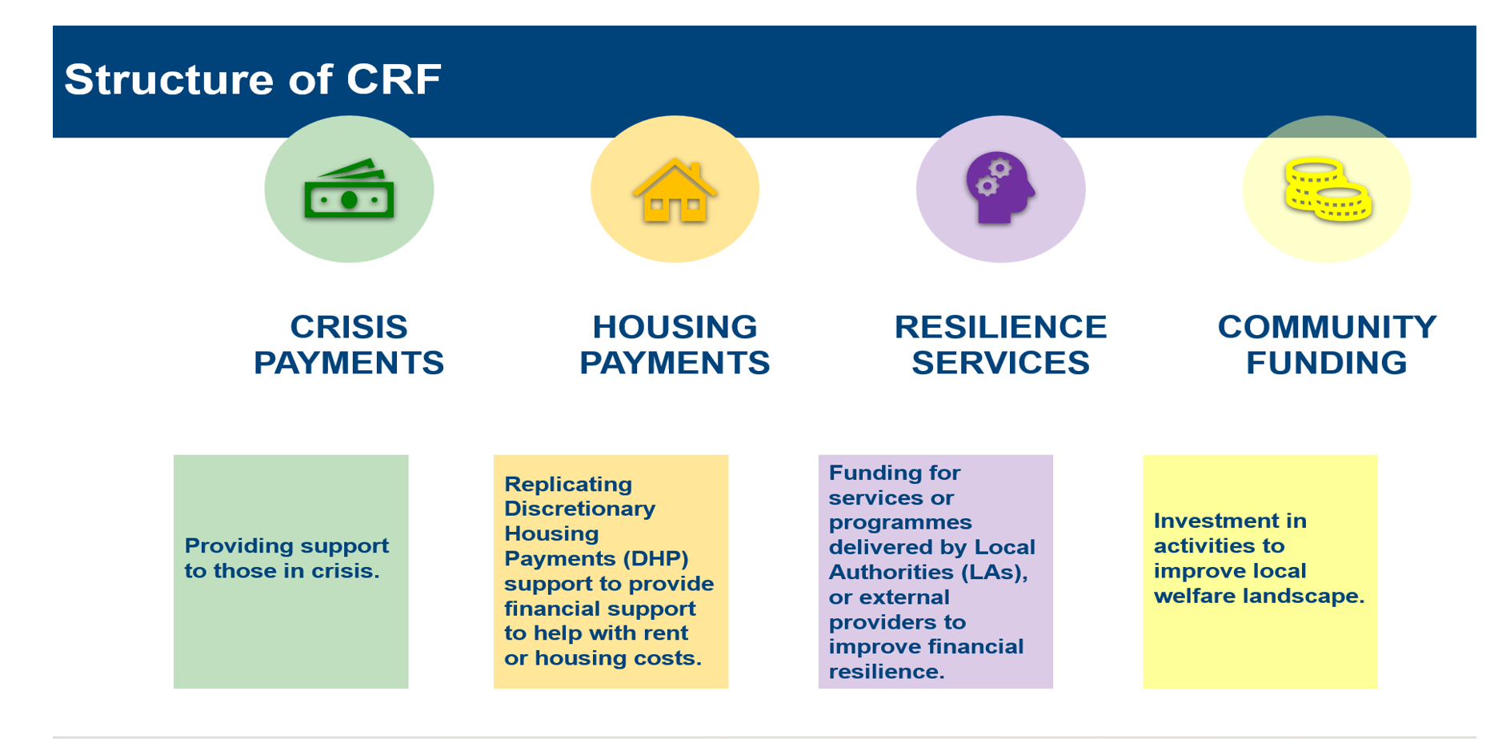
(Households with limited financial resources who experience a sudden and unforeseen drop in income or increase in essential costs that they cannot absorb without hardship)

Slide 4
Implement at Pace!.... Develop Excellence on the Way!
Implement Spring 2026 (1 April)
Working currently with existing HSF partners
‘Review and Refine’ approach to further inform and develop CaRF
Incorporate Test , Learn and Grow opportunities to inform design
Consider mitigating actions post-Household Support Fund
‘Develop’ Devon Information & Advice Network (DIAN) for greater connectivity/resilience
Enhance advice giving practice and standards (AQA / Advice First Aid campaigns?)
Via a new CaRF Partnership Board, chaired initially by Director of Public Health

Slide 5
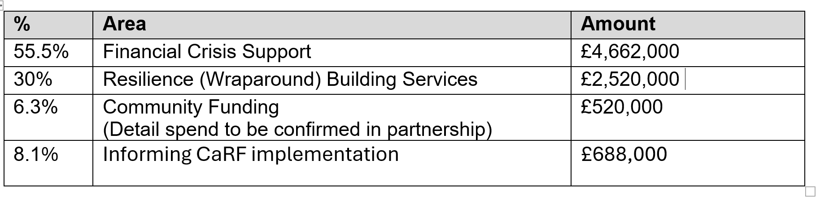
The CaRF for Devon County Council for 2026-27 - £8.4m (each year)
3 year Programme
+Housing Benefit

Slide 6
Improving the Local Landscape: Devon Information & Advice Network (DIAN)
Wider Wraparound Support
Clear, accessible and connected offers
No Doors the Wrong Door
Tell it Once
Easy to self refer to offers
Easy to make third party
‘onward’ referrals to each other
Analyse ‘usage’ data to inform further strategic development
Financial Wraparound Support
Crisis Support
Devon
Information and Advice Network Referrals
Tell it Once : No Door is the Wrong Door

Slide 7
Some further thoughts….How best might we work together on this?
Who is best placed to sit alongside operational CaRF partners (Districts and VCSE partners) on the new CaRF Partnership Board, to inform strategic matters from a VCSE perspective?
How might the wider VCSE be kept informed and connected (where appt) to the CaRF offer and its developments?
Is DIAN the right model?
Who is best placed to lead and develop the DIAN, and realise any legacies going beyond CaRF?
Could a VCSE Assembly Thematic Group (with District and County representation) add value and lead its
development?

