Slide 1
Welcome
Nicola Channon
Emergency Planning Manager
Notes:
To include
Welcome
Flu pandemic:
one of the highest rated risks!
Health led – Health agencies have emergency plans in place
Glamorous assistants Keith Reed and Ruan Kilroy

Slide 2
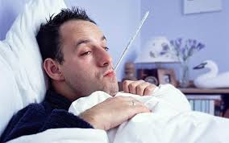
Flu Pandemic Game
Notes:
Flu pandemic game – a way of introducing consideration of the issues around flu pandemic as if you are running a small business.
Objectives:
To learn about the impact of flu pandemic on a small business and the community it serves
To have a bit of fun!

Slide 3
Oldculmbridge
Notes:
The scenario is set in Oldculmbridge a small but thriving community with a number of local businesses. I grew up here and my parents still live here, albeit in a lovely care home. I moved back here ten years ago to set up Priory Software Solutions with two other business partners ………………………………………………. (Picture is actually Sandwich in Kent)

Slide 4
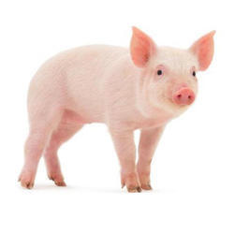
Oldculmbridge
Pit Stop Auto Services
Oldculmbridge Post Office
Old Mill Nursery and Playgroup
AtoZ Bus and Coach Company
Pricematch Supermarket
Golden Years Premier Care
Woolf and Partners Solicitors
Central Point Deliveries
Trotter’s Farm Shop
Priory Software Solutions
Notes:
We have selected nine local businesses all of which are in some way interdependent on each other for their continued success. The final one is Priory Software as we are also reliant upon other businesses for our continued success.

Slide 5
In your pack
Business Details Sheet
5 dice
Plate (if no table)
Plastic Cup
Absence Sheet
Sickness Probability Rates
Pen / Pencil
Notes:
Tell them what they can expect to receive in their envelope. Sickness probability rates are at 25% and 50% we are playing the lower probability table

Slide 6
Playing the game
Getting started
Rolling the dice
Absence sheets
Chance Cards
Discuss the impact
Notes:
Familiarise yourselves with your company. Who does what and who is key to the business. Share out the employees between your team. Nominate one person responsible for completing the absence sheet.
At the start of each round check the number of die to be used and the scores that determine whether that Employee has caught pandemic flu during that week. You throw the required number of dice for the number of times set out on the absence table FOR EACH employee. If the outcome for that week comes out for that employee (e.g. four sixes out of five dice), they are sick, and are marked absent on the absence sheet.
Complete the absence sheet. If an Employee catches the flu, the person completing the Absence Sheet marks that person absent for that week and the next 2 weeks. After 3 weeks that Employee is returned to the Game BUT that Employee does not throw the dice for them again because they are now immune from flu. However, they could still be affected by the Injects.
The Chance Cards are random events that we can throw into the game at any stage.
After every couple of rounds we will stop to discuss the impact of absences upon your business and the knock-on affect on the other businesses.

Slide 7
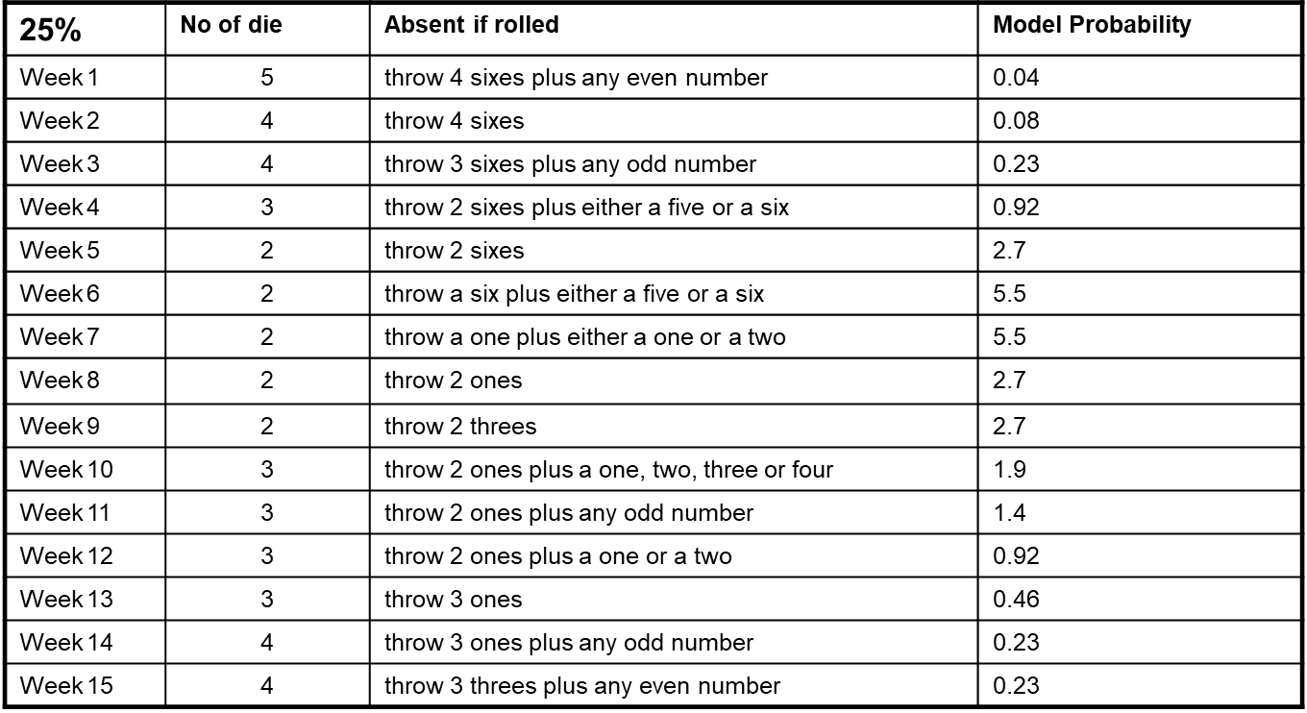
Probability
Notes:
This table is the sickness probability rates assuming 25% of the population is affected.

Slide 8
Priory Software
Notes:
Explain some of the dependencies of Priory Software. Here could say about like to get more new business. Esp Golden Years Premier Care. As you would like to see how much of the money you are paying for your parents goes on staff.
Some of our younger staff have children at the Old Mill Nursery and Playgroup, three staff use the bus to get to work from outlying villages, Once a month we have working lunches with sandwiches and drinks provided by Pricematch Supermarket.

Slide 9
Priory Software
Name of Employee: | Nicola | Julia | Keith | Kylie | Sandra | Carol | George | Ruan | William | Harry | Lorna | Kathryn | Total absent
Position | Partners |  |  | Recep/PA | Accountant | Software Specialist |  | System Install Specialist | System Maint Specialist | Helpline Advisor System Maint Specialist |  | Website designer
Week 1 | √ | √ | √ | √ | √ | √ | √ | √ | √ | √ | √ | √ | 0
Week 2 | √ | √ | √ | √ | √ | √ | √ | √ | √ | √ | √ | √ | 0
Week 3 | √ | √ | √ | √ | √ | √ | √ | √ | √ | √ | √ | X | 1
Inject 1 |  |  |  |  |  |  |  |  |  |  |  | n/a
Week 4 |  |  |  |  |  |  |  |  |  |  |  | X
Week 5 |  |  |  |  |  |  |  |  |  |  |  | X
Week 6
Inject 2
Week 7
Week 8
Week 9
Week 10
Inject 3
Week 11
Week 12
Week 13
Week 14
Week 15
Notes:
Also in Oldculmbridge is a software company they also use many of the local businesses. Let’s look at how they have been affected.

Slide 10
Inject One - Holiday
Throw three die. Get a 1 and 2 plus any other number and that employee is on leave for week four.
Throw for all unless they are already absent due to the flu. Maximum of two people taken out by this inject.
Notes:
In the early stages of a pandemic businesses may not have considered the impact planned holiday might have on the staffing levels, you were not expecting other staff to be off sick at the same time. We have restricted the number who could be on leave as that would normally be the case anyway.

Slide 11
Priory Software
Name of Employee: | Nicola | Julia | Keith | Kylie | Sandra | Carol | George | Ruan | William | Harry | Lorna | Kathryn | Total absent
Position | Partners |  |  | Recep/PA | Accountant | Software Specialist |  | System Install Specialist | System Maint Specialist | Helpline Advisor System Maint Specialist |  | Website designer
Week 1 | √ | √ | √ | √ | √ | √ | √ | √ | √ | √ | √ | √ | 0
Week 2 | √ | √ | √ | √ | √ | √ | √ | √ | √ | √ | √ | √ | 0
Week 3 | √ | √ | √ | √ | √ | √ | √ | √ | √ | √ | √ | X | 1
Inject 1 | √ | √ | √ | √ | √ | √ | √ | √ | x | x | √ | n/a | n/a
Week 4 |  |  |  |  |  |  |  |  | X | X |  | X
Week 5 |  |  |  |  |  |  |  |  |  |  |  | X
Week 6
Inject 2
Week 7
Week 8
Week 9
Week 10
Inject 3
Week 11
Week 12
Week 13
Week 14
Week 15
Notes:
Let’s see how Priory Software are doing.
Now carry on throwing the die until you have competed Week 6

Slide 12
Priory Software
Name of Employee: | Nicola | Julia | Keith | Kylie | Sandra | Carol | George | Ruan | William | Harry | Lorna | Kathryn | Total absent
Position | Partners |  |  | Recep/PA | Accountant | Software Specialist |  | System Install Specialist | System Maint Specialist | Helpline Advisor System Maint Specialist |  | Website designer
Week 1 | √ | √ | √ | √ | √ | √ | √ | √ | √ | √ | √ | √ | 0
Week 2 | √ | √ | √ | √ | √ | √ | √ | √ | √ | √ | √ | √ | 0
Week 3 | √ | √ | √ | √ | √ | √ | √ | √ | √ | √ | √ | X | 1
Inject 1 | √ | √ | √ | √ | √ | √ | √ | √ | x | x | √ | n/a | n/a
Week 4 | √ | √ | √ | √ | √ | √ | √ | √ | X | X | X | X | 4
Week 5 | √ | X | √ | √ | X | √ | √ | √ | √ | √ | X | X | 4
Week 6 | √ | X | √ | √ | X | √ | √ | √ | √ | √ | X | √ | 3
Inject 2
Week 7 |  | X |  |  | X
Week 8
Week 9
Week 10
Inject 3
Week 11
Week 12
Week 13
Week 14
Week 15

Slide 13
Inject Two - Family
Family members are sick: everyone who is currently off sick at the moment will be off work for an additional three weeks looking after other members of the family.
Notes:
In the early stages of a pandemic businesses may not have considered the impact planned holiday might have on the staffing levels, afteral you were not expecting other staff to be off sick.

Slide 14
Priory Software
Name of Employee: | Nicola | Julia | Keith | Kylie | Sandra | Carol | George | Ruan | William | Harry | Lorna | Kathryn | Total absent
Position | Partners |  |  | Recep/PA | Accountant | Software Specialist |  | System Install Specialist | System Maint Specialist | Helpline Advisor System Maint Specialist |  | Website designer
Week 1 | √ | √ | √ | √ | √ | √ | √ | √ | √ | √ | √ | √ | 0
Week 2 | √ | √ | √ | √ | √ | √ | √ | √ | √ | √ | √ | √ | 0
Week 3 | √ | √ | √ | √ | √ | √ | √ | √ | √ | √ | √ | X | 1
Inject 1 | √ | √ | √ | √ | √ | √ | √ | √ | x | x | √ | n/a | n/a
Week 4 | √ | √ | √ | √ | √ | √ | √ | √ | X | X | X | X | 4
Week 5 | √ | X | √ | √ | X | √ | √ | √ | √ | √ | X | X | 4
Week 6 | √ | X | √ | √ | X | √ | √ | √ | √ | √ | X | √ | 3
Inject 2 | √ | √ | √ | √ | x | √ | √ | √ | √ | √ | √ | √ | n/a
Week 7 |  | X |  |  | X
Week 8 |  |  |  |  | X
Week 9 |  |  |  |  | X
Week 10
Inject 3
Week 11
Week 12
Week 13
Week 14
Week 15
Notes:
Result of Inject 2 Now continue until the end of week 10

Slide 15
Priory Software
Name of Employee: | Nicola | Julia | Keith | Kylie | Sandra | Carol | George | Ruan | William | Harry | Lorna | Kathryn | Total absent
Position | Partners |  |  | Recep/PA | Accountant | Software Specialist |  | System Install Specialist | System Maint Specialist | Helpline Advisor System Maint Specialist |  | Website designer
Week 1 | √ | √ | √ | √ | √ | √ | √ | √ | √ | √ | √ | √ | 0
Week 2 | √ | √ | √ | √ | √ | √ | √ | √ | √ | √ | √ | √ | 0
Week 3 | √ | √ | √ | √ | √ | √ | √ | √ | √ | √ | √ | X | 1
Inject 1 | √ | √ | √ | √ | √ | √ | √ | √ | x | x | √ | n/a | n/a
Week 4 | √ | √ | √ | √ | √ | √ | √ | √ | X | X | X | X | 4
Week 5 | √ | X | √ | √ | X | √ | √ | √ | √ | √ | X | X | 4
Week 6 | √ | X | √ | √ | X | √ | √ | √ | √ | √ | X | √ | 3
Inject 2 | √ | √ | √ | √ | x | √ | √ | √ | √ | √ | √ | √ | n/a
Week 7 | √ | X | √ | √ | X | √ | √ | √ | √ | √ | √ | √ | 2
Week 8 | √ | √ | √ | √ | X | √ | √ | √ | √ | √ | √ | √ | 1
Week 9 | √ | √ | √ | √ | X | √ | √ | √ | √ | √ | √ | √ | 1
Week 10 | √ | √ | √ | √ | √ | √ | √ | √ | √ | √ | √ | √ | 0
Inject 3
Week 11
Week 12
Week 13
Week 14
Week 15
Notes:
Let’s see how Priory Software are doing

Slide 16
Inject Three - Schools
The local primary school has been closed. There is a 50% chance that any employee under 35 cannot work for the next two weeks until enough teaching staff return to work.
One throw of the dice per employee: throw any odd number.
Notes:
Children are very good at spreading germs but the advice to schools will be to stay open where possible as the implications of closing impacts upon the community as a whole. A school closure could happen for other reasons such as severe weather. This has come quite late in the table. It could be that the virus has changed.

Slide 17
Priory Software
Name of Employee: | Nicola | Julia | Keith | Kylie | Sandra | Carol | George | Ruan | William | Harry | Lorna | Kathryn | Total absent
Position | Partners |  |  | Recep/PA | Accountant | Software Specialist |  | System Install Specialist | System Maint Specialist | Helpline Advisor System Maint Specialist |  | Website designer
Week 1 | √ | √ | √ | √ | √ | √ | √ | √ | √ | √ | √ | √ | 0
Week 2 | √ | √ | √ | √ | √ | √ | √ | √ | √ | √ | √ | √ | 0
Week 3 | √ | √ | √ | √ | √ | √ | √ | √ | √ | √ | √ | X | 1
Inject 1 | √ | √ | √ | √ | √ | √ | √ | √ | x | x | √ | n/a | n/a
Week 4 | √ | √ | √ | √ | √ | √ | √ | √ | X | X | X | X | 4
Week 5 | √ | X | √ | √ | X | √ | √ | √ | √ | √ | X | X | 4
Week 6 | √ | X | √ | √ | X | √ | √ | √ | √ | √ | X | √ | 3
Inject 2 | √ | √ | √ | √ | x | √ | √ | √ | √ | √ | √ | √ | n/a
Week 7 | √ | X | √ | √ | X | √ | √ | √ | √ | √ | √ | √ | 2
Week 8 | √ | √ | √ | √ | X | √ | √ | √ | √ | √ | √ | √ | 1
Week 9 | √ | √ | √ | √ | X | √ | √ | √ | √ | √ | √ | √ | 1
Week 10 | √ | √ | √ | √ | √ | √ | √ | √ | √ | √ | √ | √ | 0
Inject 3 | √ | √ | √ | √ | √ | √ | √ | √ | √ | √ | √ | x | n/a
Week 11 |  |  |  |  |  |  |  |  |  |  |  | X
Week 12 |  |  |  |  |  |  |  |  |  |  |  | X
Week 13
Week 14
Week 15
Notes:
Let’s see how Priory Software are doing

Slide 18
Priory Software
Name of Employee: | Nicola | Julia | Keith | Kylie | Sandra | Carol | George | Ruan | William | Harry | Lorna | Kathryn | Total absent
Position | Partners |  |  | Recep/PA | Accountant | Software Specialist |  | System Install Specialist | System Maint Specialist | Helpline Advisor System Maint Specialist |  | Website designer
Week 1 | √ | √ | √ | √ | √ | √ | √ | √ | √ | √ | √ | √ | 0
Week 2 | √ | √ | √ | √ | √ | √ | √ | √ | √ | √ | √ | √ | 0
Week 3 | √ | √ | √ | √ | √ | √ | √ | √ | √ | √ | √ | X | 1
Inject 1 | √ | √ | √ | √ | √ | √ | √ | √ | x | x | √ | n/a | n/a
Week 4 | √ | √ | √ | √ | √ | √ | √ | √ | X | X | X | X | 4
Week 5 | √ | X | √ | √ | X | √ | √ | √ | √ | √ | X | X | 4
Week 6 | √ | X | √ | √ | X | √ | √ | √ | √ | √ | X | √ | 3
Inject 2 | √ | √ | √ | √ | x | √ | √ | √ | √ | √ | √ | √ | n/a
Week 7 | √ | X | √ | √ | X | √ | √ | √ | √ | √ | √ | √ | 2
Week 8 | √ | √ | √ | √ | X | √ | √ | √ | √ | √ | √ | √ | 1
Week 9 | √ | √ | √ | √ | X | √ | √ | √ | √ | √ | √ | √ | 1
Week 10 | √ | √ | √ | √ | √ | √ | √ | √ | √ | √ | √ | √ | 0
Inject 3 | √ | √ | √ | √ | √ | √ | √ | √ | √ | √ | √ | x | n/a
Week 11 | √ | √ | √ | √ | √ | √ | √ | √ | √ | √ | √ | X | 1
Week 12 | √ | √ | √ | √ | √ | √ | √ | √ | √ | √ | √ | X | 1
Week 13 | √ | √ | √ | √ | √ | √ | √ | √ | √ | √ | √ | √ | 0
Week 14 | √ | √ | √ | √ | √ | √ | √ | √ | √ | √ | √ | √ | 0
Week 15 | √ | √ | √ | √ | √ | √ | √ | √ | √ | √ | √ | √ | 0
Notes:
Let’s see how Priory Software are doing
If we are doing well can say it is because we encourage staff to have the flu jab.

Slide 19
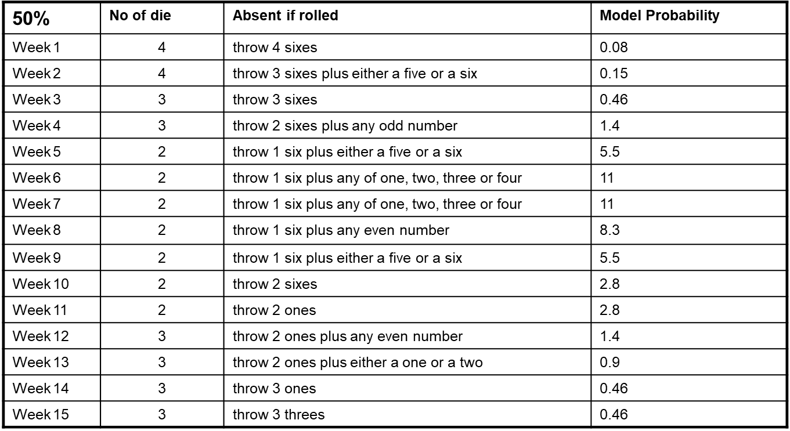
Worst Case
Notes:
If playing a second time use the 50% rate.
Familiarise yourselves with your company. Who does what and who is key to the business. Share out the employees between your team.
At the start of each round check the number of die to be used and the scores that determine whether that Employee has caught pandemic flu during that week. You throw the dice for the number of times set out on the absence table FOR EACH employee. If the outcome for that week comes out for that employee, they are sick, and are marked absent on the absence sheet.
Complete the absence sheet. If an Employee catches the flu, the person completing the Absence Sheet marks that person absent for that week and the next 2 weeks. After 3 weeks that Employee is returned to the Game BUT the player looking after that Employee does not throw the dice for them again because they are now immune from flu. However, they could still be affected by the Chance Cards.
The Chance Cards are random events that we can throw into the game at any stage.
After every couple of rounds we will stop to discuss the impact of absences upon your business and the knock-on affect on the other businesses.

Slide 20
Summary
A flu pandemic is just one reason why staff, supplies or fuel might be in short supply. It is important that local businesses have business continuity plans and that communities play their part in helping to keep their services going in times of need.
Knowing who is vulnerable in your community is key, not just elderly but people living on their own and those who rely on medication – at any age

Slide 21
Summary
Everyone has a role to play in ensuring that their community can cope in all types of emergency – what could you do?

