Slide 1
Lapford Emergency Action Plan
LEAP

Slide 2
History
Twenty years since Lapford first considered Emergency Planning
Parish Councillors attended the first meeting of the Devon Resilience Forum
A small committee was formed
The first draft of a workable plan emerged

Slide 3
Personnel
Parish Council sub-committee
Currently 3 Parish Councillors plus five community members
Committee comprises ex-service personnel, a qualified para-medic, 3 people with two-way radio licences
Can call on a wider group in the community – Police experience, Marine, Engineers, Farmers

Slide 4
Getting-going - Context
Reasons for a plan
South-facing hillside, reasonably steep, main A377 Exeter to Barnstaple road + railway line + river
Distance away from emergency services
Main potential problems - flooding, snow & ice
Poor/patchy mobile phone coverage

Slide 5
Lapford

Slide 6
Risk Assessments
The basis for the plan:
Snow and ice
Flooding, high winds & storm damage
Industrial/farm accidents
Road traffic accidents
Fire – thatched properties
Pandemic - flu

Slide 7
Writing the Plan
Collaboration
Skeleton – Triggers
Contact numbers
Local facilities
Vulnerable persons
Desirable Equipment
Control base
Separate Flood Plan

Slide 8
Communication
Inform the community
Booklet to every house
Local information to every house
Regular updates
Targeted communication

Slide 9
Personnel & Training, Action Team
Recruitment
Flood warden plus helpers
Snow warden plus helpers
Training – flood
Training – resuscitation & defibrillator
Resilience Forum

Slide 10
Equipment
Control Centre – telephone, internet, maps, storage
Sand, sand bags, hopper, flood boards
Hi-viz, torches, first aid kits, whistles, floodlights, two-way radios
Traffic signs
Stretcher

Slide 11
Next Steps
Table-top exercise
Respite Centre exercise
More volunteers
Link to adjoining parishes
Continued training
Revise plan

Slide 12
Table-Top Exercise
Two hours
Detailed local maps
Alternative means of communication essential
Keep records of everything
Local knowledge is key
No lone working
Basic information/equipment in place

Slide 13
Pitfalls & Lessons Learned
Simplicity
Personal approach
Regular communication
Personal and community strategies
Not experts
Can help the community to cope
Work with the Emergency Services

Slide 14
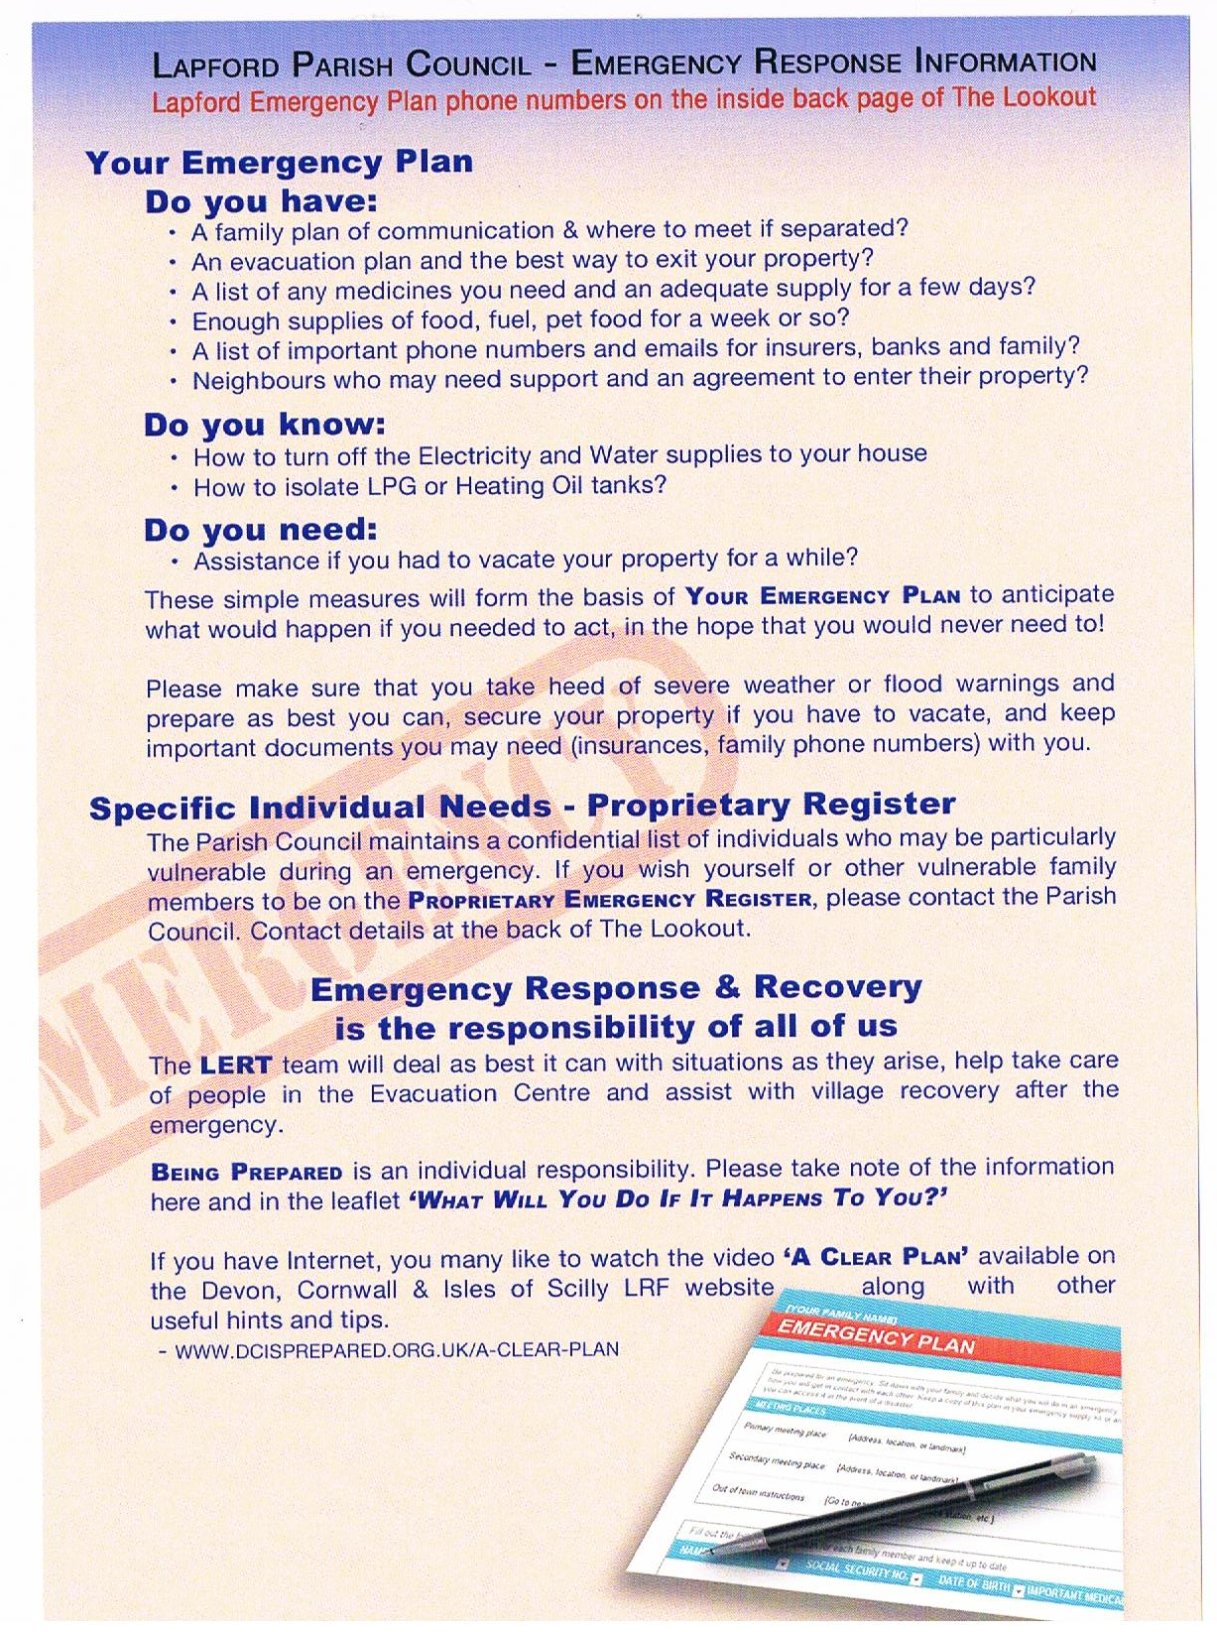
Thank You

