Slide 1
Emergency Planning Workshop for Parishes
Welcome

Slide 2
Louise MacAllister
Martin Rich

Slide 4
Housekeeping
Introductions
Programme

Slide 5
Preparing for emergencies
What is community resilience and why is it important?
Benefits of community resilience
What you can do to help
What is a resilient community?
Community emergency planning

Slide 6
The Big Picture
Civil Contingencies Act 2004 -
A single framework for civil protection
Category 1—emergency services, local authorities, NHS
Assess risk of emergencies as the basis for plans
Put in place emergency plans
Business continuity
Public information
Share and enhance
Co-operate
provision of advice and assistance to the commercial sector and voluntary organisations. (LA’s only)
Category 2 - utilities, transport, HSE
Co-operate with each other and Cat 1 responders
Local resilience forums
Category 1 & 2 organisations coming together in order to help co-operation between responders at the local level.

Slide 7
Devon Community Resilience Board & Forum
Vision statement
“To work with communities and individuals to develop and enhance their ability to harness local resources and expertise, to help themselves plan for, respond to and recover from emergencies.”
Objectives
The Board will consult with the Forum in order to direct resources to increase:
the dialogue between communities and forum partners on issues of community resilience
individual, family and community resilience
awareness of local risk; the benefits to the community of being prepared and the role of emergency responders
support and capability available in the community to develop and enhance resilience
Governance
A Board consisting of:
local authorities, ‘blue light’ services, Category 2, Environment Agency, DALC, DCT representatives.
Purpose:
To identify areas of work in community resilience, ensuring that activity is co-ordinated, lessons learned and that the best use of resources is being achieved.

Slide 8
Emergency:
A serious, unexpected, and often dangerous situation requiring immediate action. (OED)

A situation that poses an immediate risk to health, life, property, or environment.
Most emergencies require urgent intervention to prevent a worsening of the situation, although in some situations, mitigation may not be possible and agencies may only be able to offer palliative care for the aftermath. (Wikipedia)

An event or situation that threatens serious damage to human welfare in a place in the UK or to the environment of a place in the UK, or war or terrorism which threatens serious damage to the security of the UK. To constitute an emergency this event or situation must require the implementation of special arrangements by one or more Category 1 responder. (Cabinet Office)

Slide 9
Your turn:
List the kinds of emergencies that might affect a community:

Slide 10
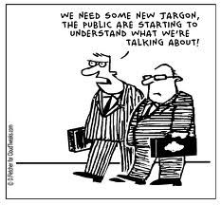

Slide 11
Bronze
The tier of command and control within a single agency or multi agency (below gold level and silver level) at which the management of ‘hands-on’ work is undertaken at the
incident site(s) or associated areas.
Note: The bronze level is also known as the operational level.
Business continuity plan (BCP)
Documented collection of procedures and information developed, compiled and maintained in readiness for use in an incident to enable an organisation to continue to deliver its critical activities at an acceptable pre-defined level.
Capability gap
The gap between the current ability to provide a response and the actual response assessed to be required for a given threat or hazard. Plans should be made to reduce or eliminate this gap, if the risk justifies it.

Slide 12
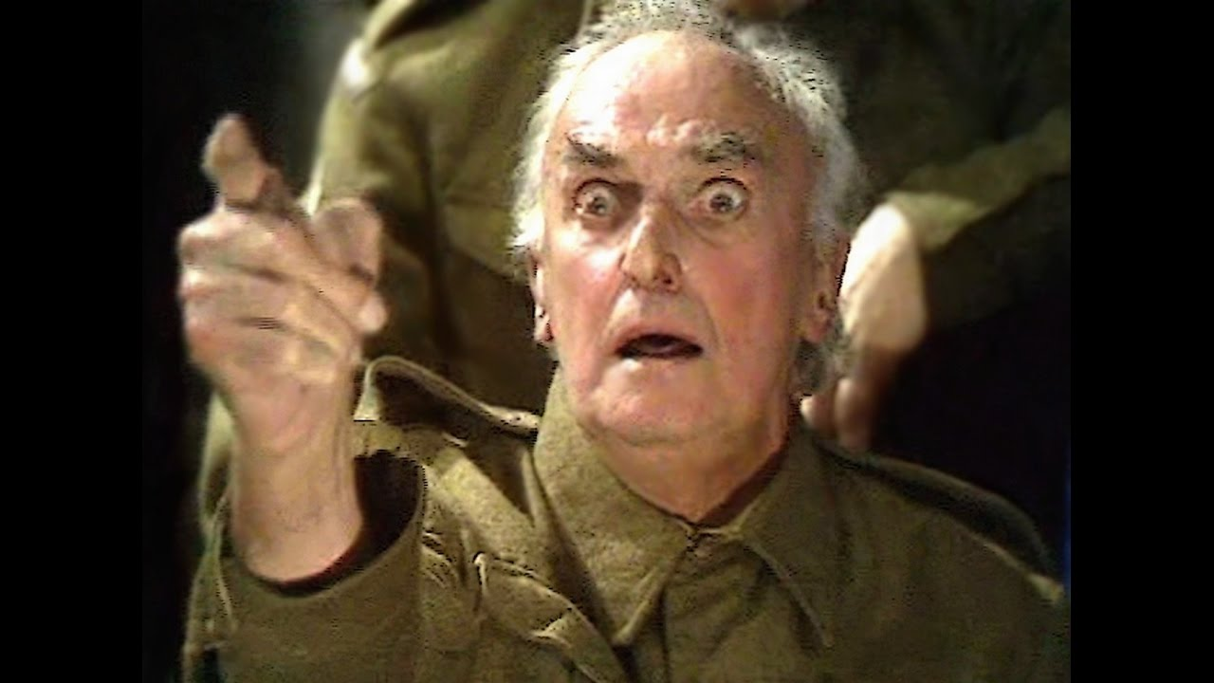
Catastrophic emergency
An emergency that has an exceptionally high and potentially widespread impact and
requires immediate central government direction and support.

Slide 13
Community engagement
Mechanisms for identifying community views and the channels for understanding engagement. Developing such mechanisms and channels entails building infrastructure and capacity amongst community groups.
Community resilience
Communities and individuals harnessing local resources and expertise to help themselves in an emergency, in a way that complements the response of the emergency services.
Community Risk Register (CRR)
A register communicating the assessment of risks within a Local Resilience Area which is developed and published by a Local Resilience Forum as a basis for informing local communities and directing civil protection work streams.

Slide 14
Data Protection Act
An Act that requires organisations which hold data about individuals to do so securely and only for specific purposes.
The Act also gives individuals the right, with certain exemptions, to see personal data that relates to them.

Slide 15
Emergency Plan
A document or collection of documents that sets out the overall framework for the initiation, management, co-ordination and control of personnel and assets to reduce, control or mitigate the effects of an emergency.
Emergency planning
Aspect of Integrated Emergency Management concerned with developing and maintaining procedures to prevent emergencies and to mitigate the impact when they occur.
Emergency planning cycle
A continuous process of assessing the risk of and preparing for emergencies, supported by procedures to keep staff in readiness, and to review and validate plans, revising them, if necessary, following emergency exercises or response operations.

Slide 16
Hazard
Accidental or naturally occurring (i.e. non-malicious) event or situation with the potential to cause death or physical or psychological harm, damage or losses to property, and/or disruption to the environment and/or to economic, social and political structures.
Hazard assessment
A component of the civil protection risk assessment process in which identified hazards are assessed for risk treatment.
Hazard identification
A component of the civil protection risk assessment process by which potential hazards are identified. This can also be carried out locally during the process of developing a community risk register.
Major incident
Event or situation requiring a response under one or more of the emergency services’ major incident plans.
Note: while an ‘emergency’ as specifically defined under the CCA and ‘major incident’ are not synonymous, they are both significant events with serious consequences. It does not automatically follow from the declaration of a major incident that it will meet the criteria for a CCA-defined emergency, but the definitions and criteria overlap and in many cases an emergency will be a major incident and vice versa.

Slide 17
Resilience
Ability of the community, services, area or infrastructure to detect, prevent, and if necessary, to withstand, handle and recover from disruptive challenges.
What does a resilient community look like?
• Are aware of risks that may affect them (both nationally and locally) and how vulnerable they are to such risks. This helps motivate them to personally take action to prepare for the consequences of emergencies.
• Work in partnership to complement the work of the local emergency responders and other organisations before, during and after an emergency.
• Use existing skills, knowledge and resources to prepare for, and deal with, the consequences of emergencies.

Slide 18
Risk
A measure of the significance of a potential emergency in terms of its assessed likelihood and impact.
Risk appetite
Willingness of an organisation to tolerate a defined level of risk.
Risk assessment
A structured and auditable process of identifying potentially significant events, assessing their likelihood and impacts, and then combining these to provide an overall assessment of risk, as a basis for further decisions and action.
Risk management
All activities and structures directed towards the effective assessment and management of risks and their potential adverse impacts.
Risk priority
The relative importance of the treatment(s) required for the management of the risk, based on the risk rating and the additional capabilities required to manage risk.
Risk rating matrix
Table showing the likelihood and potential impact of events or situations, in order to ascertain the risk.
Risk treatment
Process of determining those risks that should be controlled (by reducing their likelihood and/or putting impact mitigation measures in place) and those that will be tolerated at their currently assessed level.

Slide 19
Tea time!

Slide 20
Your turn:
With all this infrastructure in place, why do we need community plans and responders?

Slide 21
Planning for an emergency
Identify your community.
Identify local relationships and getting people involved.
Community emergency groups and co-ordinators.
Identifying the most vulnerable.
Identifying and preparing for risks - social / environmental / infrastructure
Assessing local skills and resources – volunteers / tools / supplies / transport
Insurance / Health & Safety
Identify key locations
Emergency contacts list

Slide 22
What to do in an emergency
Activation of your plan
First Community Emergency Group meeting
Evacuation
Communications

Slide 23
Practising and reviewing a plan
Sharing a plan
Reviewing and updating a plan

Slide 24
Preparing as individuals and families
Make local residents aware of how to prepare:
These resources help people to quickly prepare for the hazards and threats that may affect them.
Make sure you have suitable insurance.
Think about where you would go and stay – and how you would get there – if an emergency meant that you couldn’t stay at home.
Make an emergency plan or a flood plan and discuss it with your family and friends so they know what to do.
Put together a ‘grab bag’ of things to take in an emergency.

Slide 25
Help from DCT
Web site: https://www.devoncommunities.org.uk/projects/devon-community-resilience-forum
Telephone & email support to create a CEP
07984001542 – martin@devoncommunities.org.uk
Training and information events
Links to DCRB members for specific advice
Funding
https://www.devoncommunities.org.uk/grant-funding-emergency-flood-resilience
Dissemination of your CEP

Slide 26
Devon Community Resilience Fund

Slide 27
Community EP Toolkit
+
Model Emergency plan template
=
Happy Days!!!!

Slide 28
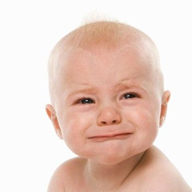
+
time
+
effort
+
dedication
+
patience

Slide 29
Questions ???

Slide 30
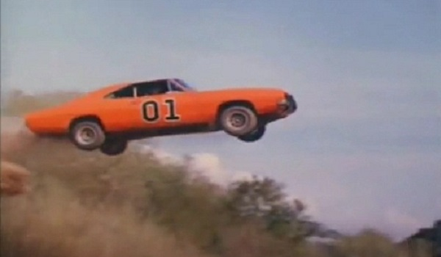
Have a safe journey home

